Slide 1




EXCELSSIOR EDUCATION SOCIETY’S K. C. COLLEGE OF ENGINEERING AND MANAGEMENT STUDIES AND RESEARCH (Affiliated to the University of Mumbai) Mith Bunder Road, Near Hume Pipe, Kopari, Thane(E)-400603
Department of Information Technology
Academic Year 2024-25(Even Semester)

Slide 2
Vision
To create IT graduates with ethical and employable skills.
Mission
To imbibe problem solving and analytical skills through teaching learning process.
To impart technical and managerial skills to meet the industry requirement.
To encourage ethical and value based education.

Slide 3
MAJOR PROJECT
PRESENTATION
SEM – VIII (2024-2025)

Slide 4
Ai Powered Legal Advisor Assistant
Group members :
1)Rohan Surve(57)
2)Abhishek Singh(55)
3)Ajit Sargar(47)
4)Sudhanshu mohite(29)
Name Of Guide
Asst. Prof. Punam Bagul

Slide 5
Index
Introduction to Topic
Need of Project
Problem Statement
Literature survey In Tabular Format
Algorithm for Project Development
Block Diagram/ Architecture
Flow-chart
Requirement Hardware and Software
Feasibility Study
Proposed Methodology
Detail Design DFD Diagram
Implementation Details/ Screenshots of GUI
References(Books, Websites, Databases Etc.)
Conclusion
Future Scope

Slide 6
INTRODUCTION
Legal services are essential in modern society, but they can be complex, time-consuming, and expensive.
Traditional legal assistance often requires specialized expertise and significant financial resources, making it inaccessible for many individuals and small businesses.
AI-powered legal advisor systems offer an innovative solution to these challenges by combining the power of Artificial Intelligence (AI) with the complexities of legal processes.
These systems are designed to provide quick, cost-effective, and efficient legal assistance to users by automating tasks like legal research, document drafting, case analysis, and answering legal queries.
This project aims to create a legal advisor assistant powered by AI that can help individuals and organizations navigate legal issues with greater efficiency, improving access to justice while reducing the cost and time of legal consultations.

Slide 7
NEED OF PROJECT
The legal industry faces several key challenges:
High Costs: Traditional legal advisory services are expensive, often making them inaccessible to small firms or individual clients.
Time-Consuming Processes: Lawyers spend a significant amount of time performing manual research, document reviews, and case preparation.
Human Error: The complexity of legal documentation increases the likelihood of errors during research and contract drafting.
Access to Legal Services: Many individuals and small businesses are unable to afford quality legal assistance, creating a gap in legal support for vulnerable populations.

Slide 8
PROBLEM STATEMENT
The legal sector is burdened by inefficiencies in legal research, document drafting, and case analysis. Lawyers spend long hours manually reviewing legal texts, contracts, and compliance documents, leading to delays and increased legal costs. These traditional methods also introduce room for human error, making the legal process less efficient and sometimes inaccurate.
The problem is how to:
Develop an AI-powered solution that can autonomously perform legal research and contract analysis.
Enable real-time legal advice and support, particularly for small law firms and individuals who lack the financial resources for traditional legal services.
It bridges the gap between complex legal service and users, making legal support more accessible.
Legal professionals are overwhelmed by repetitive tasks like research and document preparation.
The AI assistant automates routine tasks, boosting productivity for legal professionals.
Ensure the AI solution adheres to legal standards and ensures data privacy, ethics, and compliance.

Slide 9
LITERATURE SURVEY
Sr.no | Year | Title | Author | Objective | Methodology
1 | 2023 | Large Language Models in Legal AI Systems | Malik, K., et al. | To investigate the application of large language models in legal AI systems.. | Analysis of GPT-3 and GPT-4 in legal document review, query resolution, and legal advice generation.
2 | 2023 | AI-Driven Legal Assistants: The Future of Legal Advice | Shah, V. | To explore the role of AI-driven legal assistants in providing real-time legal advice. | Review of conversational AI systems and their potential for democratizing legal advice.
3 | 2022 | AI for Legal Document Automation: A Case Study of Contract Generation | Li, J. & Qin, L. | To analyze AI-based automated contract generation systems | Case study of AI systems for drafting contracts based on templates and user input..
4 | 2021 | AI in Legal Assistance: Document Automation and Interactive Systems | Pasquale, F. | To study the use of AI for automating legal documents and providing interactive legal services. | Case studies of AI tools like DoNotPay and other interactive legal systems.

Slide 10
Sr.no | Year | Title | Author | Objective | Methodology
5 | 2021 | Natural Language Processing for Legal Text: Challenges and Opportunities | Chalkidis, I. & Androutsopoulos, I. | To analyze the challenges of applying NLP to legal texts. | Review of advancements in NLP models like BERT and GPT-3 for legal document interpretation.
6 | 2020 | Ethical Challenges in AI-Powered Legal Decision-Making | Wischmeyer, T. & Rademacher, T. | To investigate ethical concerns in AI-based legal decision-making. | Examination of AI bias, transparency, and accountability in legal decision-making systems.
7 | 2019 | Artificial Intelligence and the Future of Law: Predictive Justice Systems | Susskind, R.. | To explore the concept of predictive justice using AI. | Analysis of AI tools for predicting court outcomes based on case law and precedents.
8 | 2018 | Smart Contracts and AI’s Impact on Transactional Law | McGinnis, J. & Pearce, R. | To investigate the role of AI in automating transactional law, including contract drafting. | Case study on the automation of contract generation using smart contracts and AI tools.

Slide 11
Algorithm for Project Development
Start
User Authentication
User registers/logs in to access the system.
Lawyers log in to manage cases and documents.
Chatbot Interaction
User asks legal queries in the chatbot.
NLP processes the query and identifies intent.
Chatbot fetches relevant legal sections from the database.
Response is displayed to the user.
Blog Section Access
Users can explore legal blogs for insights.
Clicking on a blog opens the detailed article.
Legal Document Generation

Slide 12
Users fill in application forms for legal documents.
Lawyers can upload legal templates for user reference.
The system generates customized legal documents.
Data Storage & Security
User and lawyer data is securely stored.
Legal documents are encrypted for privacy.
end

Slide 13
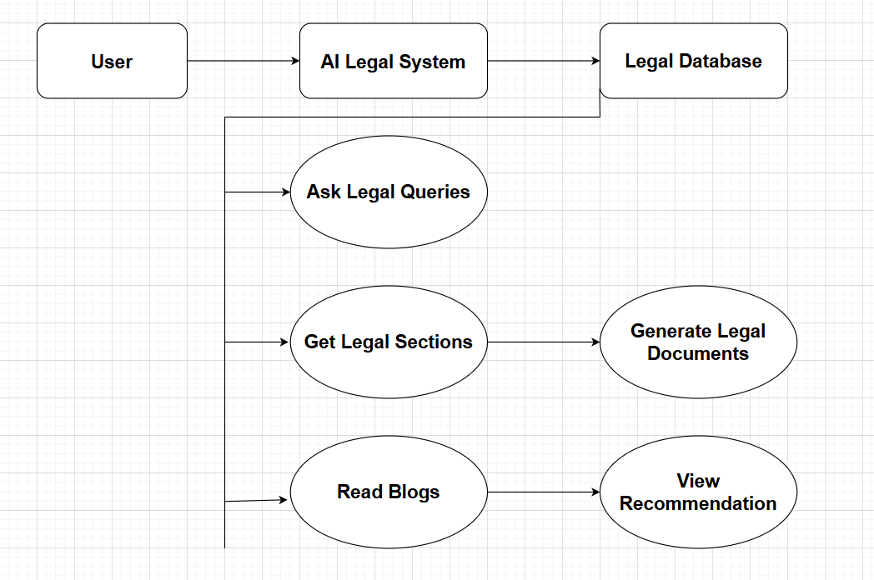
Block Diagram

Slide 14
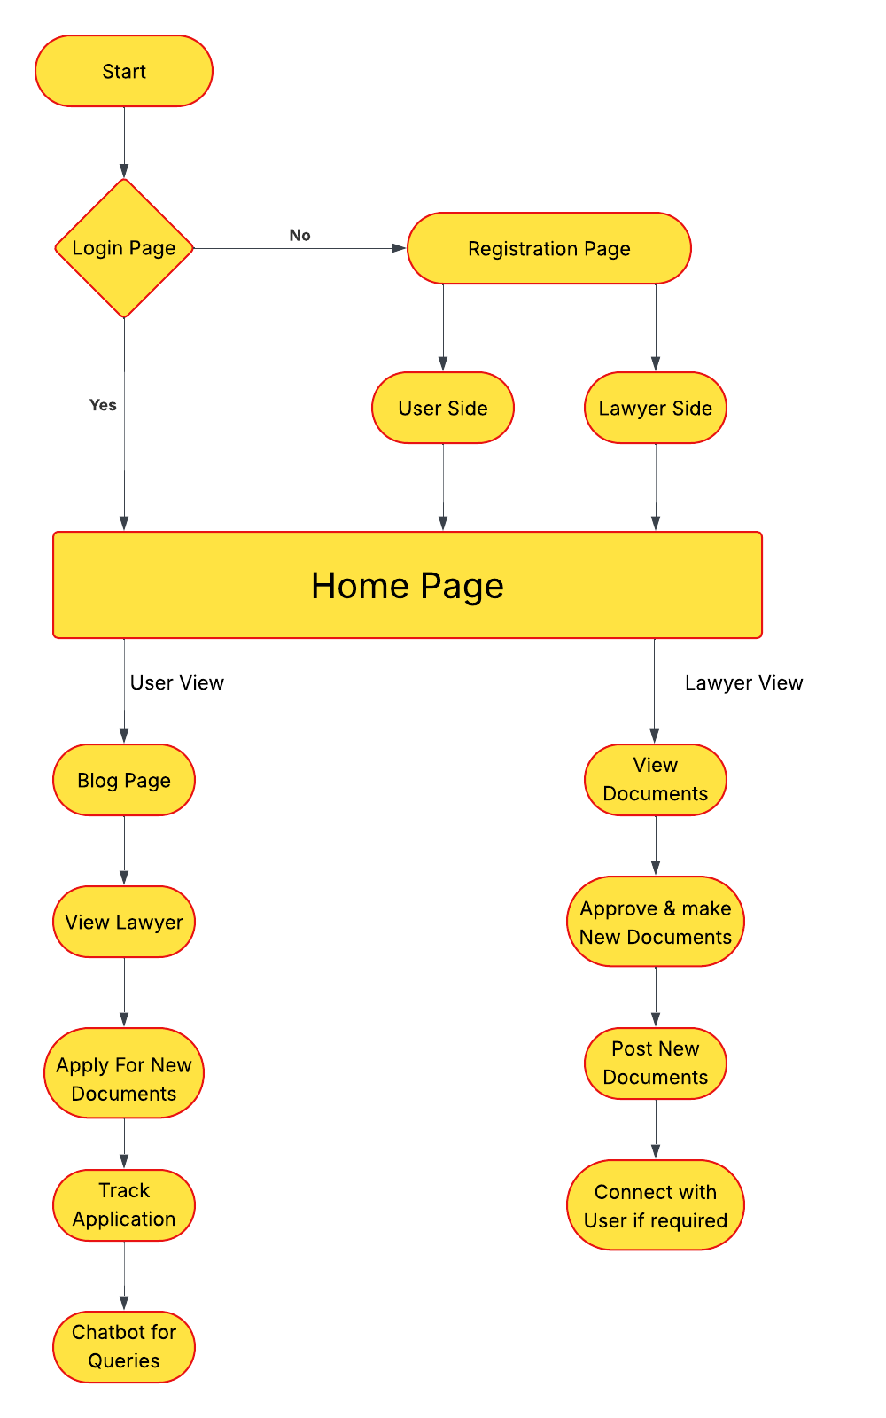
Flow Chart

Slide 15
REQUIREMENT S/W AND H/W
Requirements | Software | Hardware
Operating System | Windows, macOS, or Linux | Desktop/Laptop (Processor i3 and above)
Database | MongoDB for data storage | RAM (8GB recommended)
API Handling | Node.js, Express.js for handling API requests | Storage: At least 500 GB SSD for database storage and AI model data
AI Libraries | OpenCV, TensorFlow | Minimum 16 GB RAM for handling AI model operations and concurrent user requests

Slide 16
FEASIBILITY STUDY
Technical Feasibility: AI models such as GPT-4 and BERT are capable of understanding and processing legal texts. These models can be integrated into legal systems to analyze documents, answer legal queries, and generate recommendations.
Economic Feasibility: The development costs of AI systems are outweighed by the long-term benefits, including reduced labor costs, faster processing times, and higher accuracy in legal tasks.
Legal Feasibility: AI systems must comply with privacy laws and maintain data security to ensure the confidentiality of legal matters.

Slide 17
PROPOSED METHODOLOGY
The Scope of an AI-Powered Legal Advisor Assistant spans various application within in the legal field, such as:
Legal Research Automation : AI can help in quickly identifying relevant case law, statutes and regulations.
Contract Review and Analysis : AI models can analyze contracts to identify risks, inconsistencies and areas for improvement, speeding up the review process and minimizing the risk of human error.
Predictive Legal Analytics : AI can predict potential case outcomes by analyzing historical case data, helping legal professionals strategize better about possible verdicts.
Compliance Management : AI systems can continuously monitor regulations to ensure businesses comply with the latest legal requirements.

Slide 18
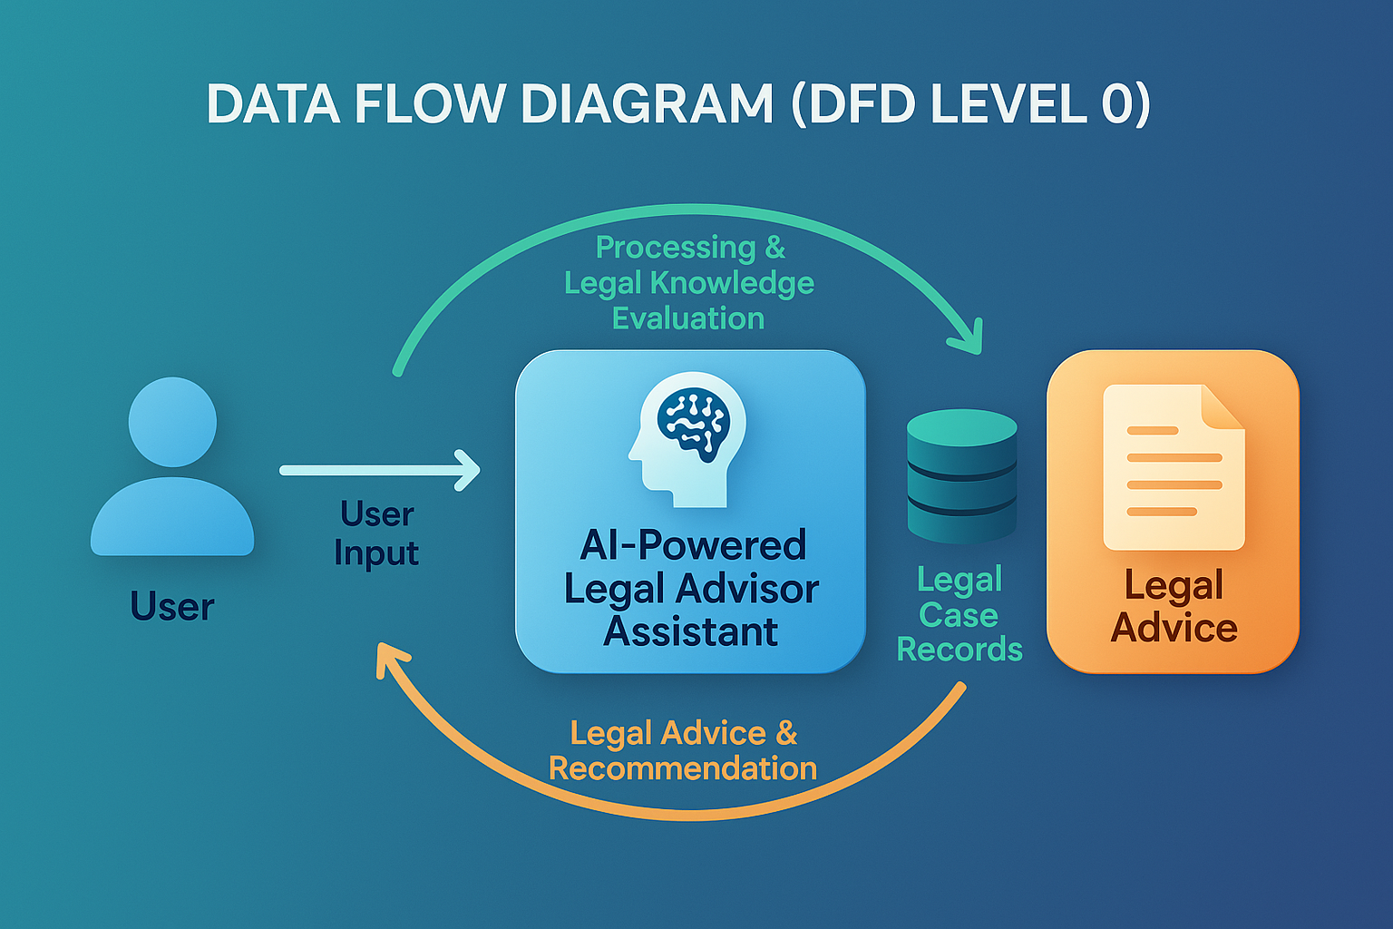
Detail Design DFD Diagram
DFD Level 0

Slide 19
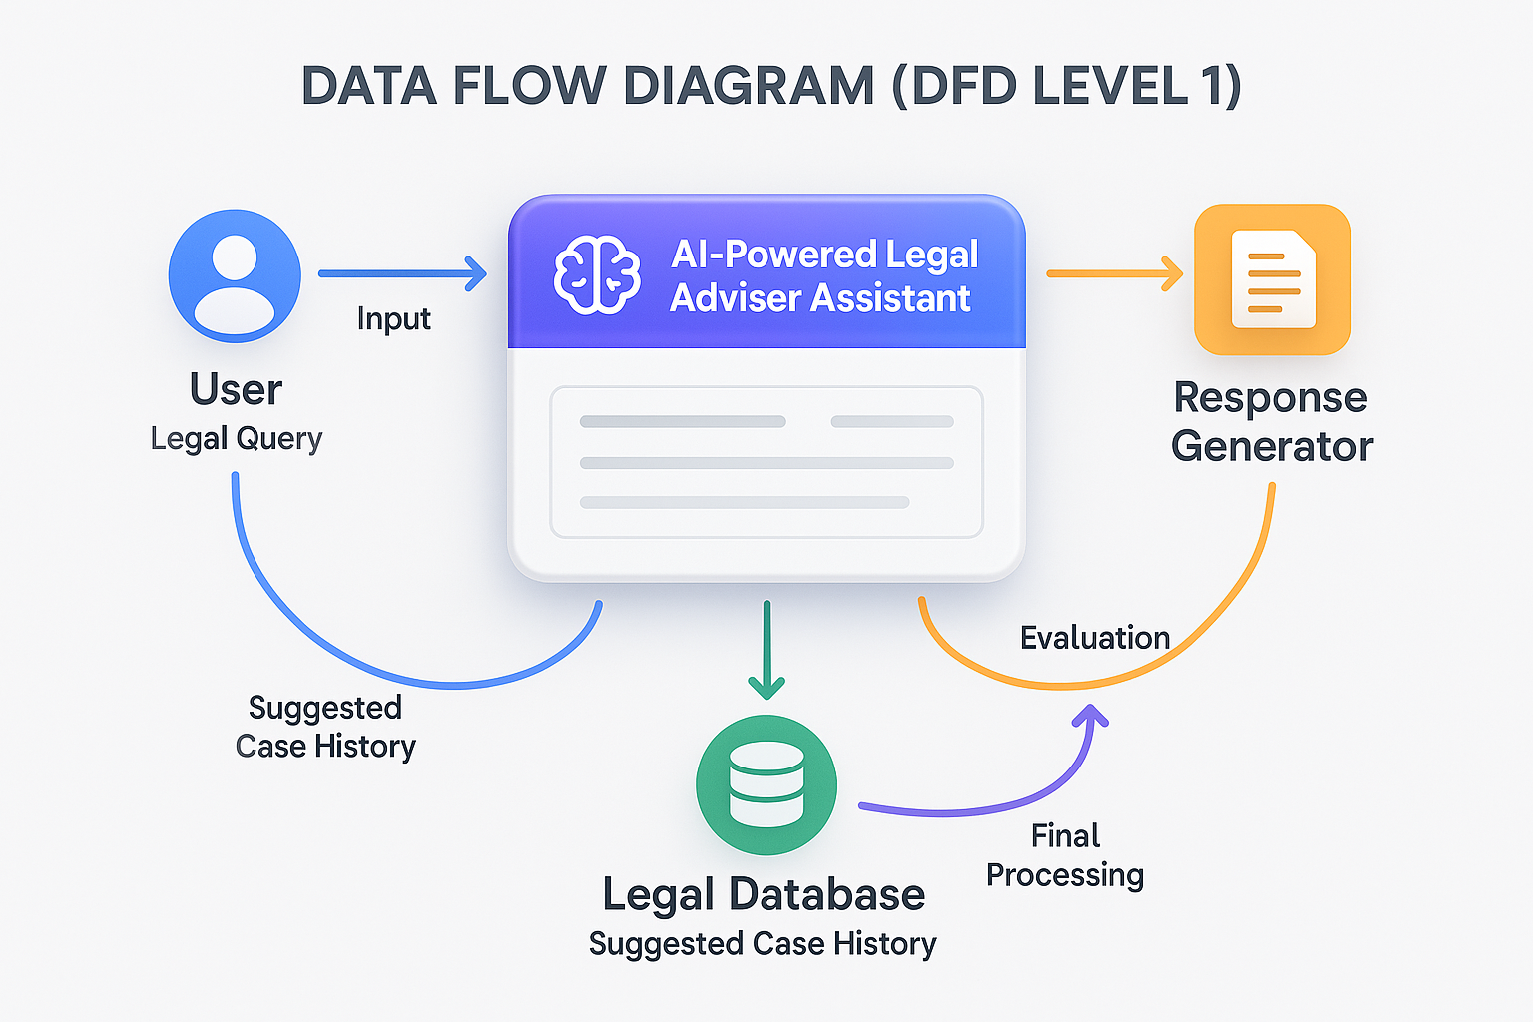
DFD LEVEL 1

Slide 20
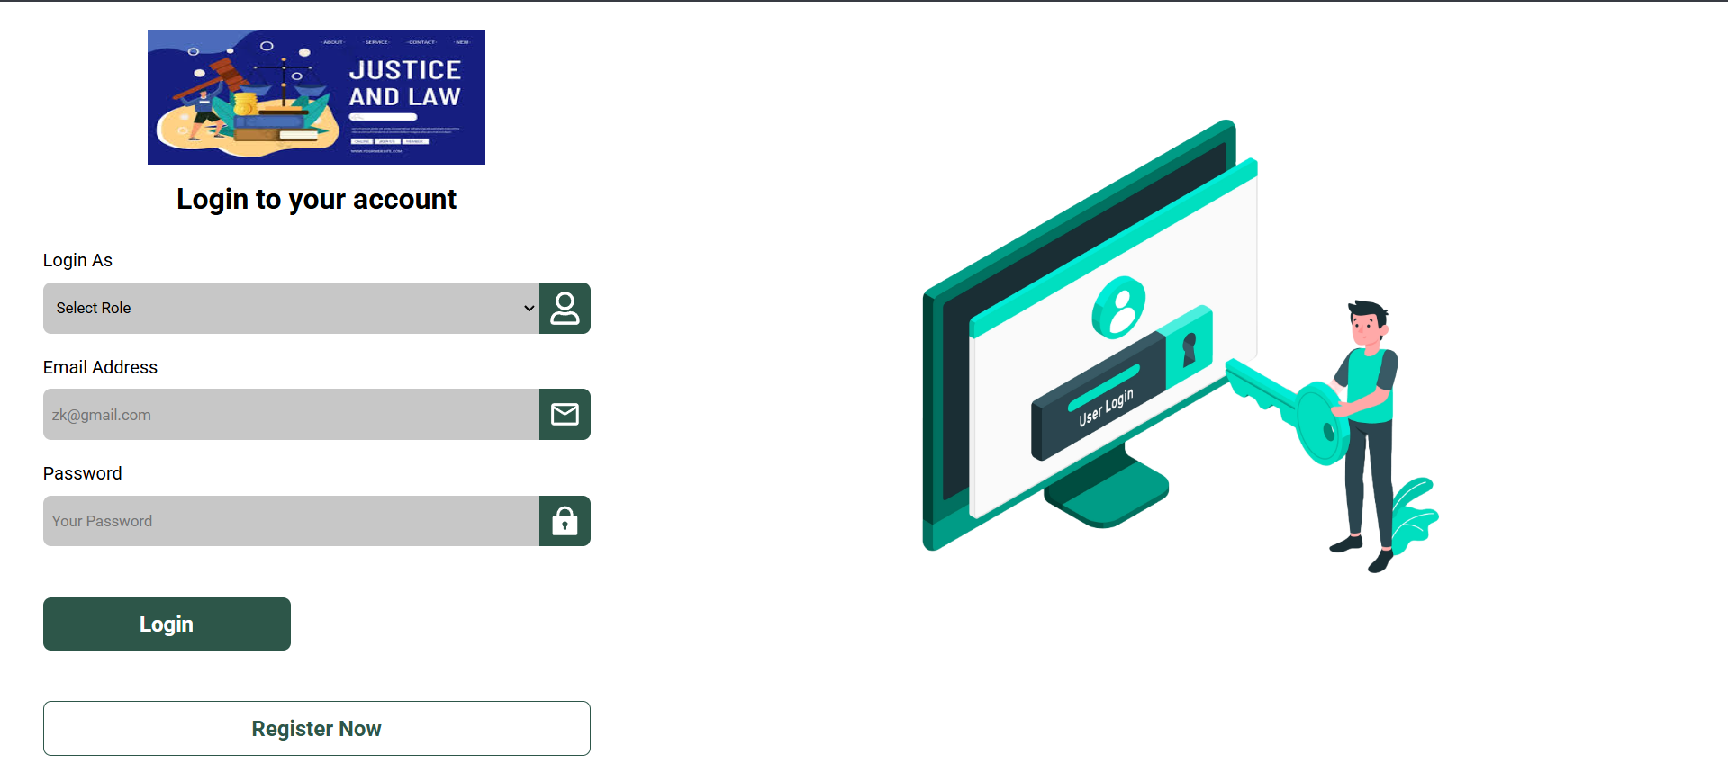
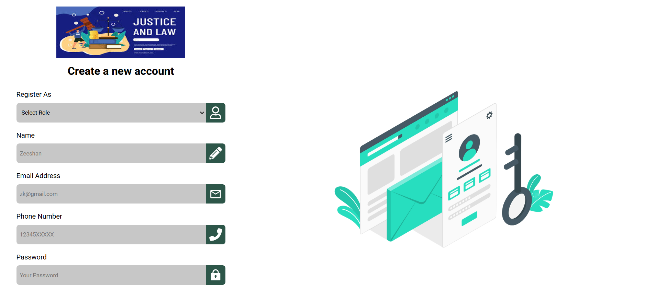
IMPLEMENTAION DETAILS / SCREENSHOT OF GUI
Login Page
The login page ensures secure user authentication, providing seamless access to legal assistance.
Register Page
The registration page enables users to create accounts securely, ensuring proper access to legal services.

Slide 21
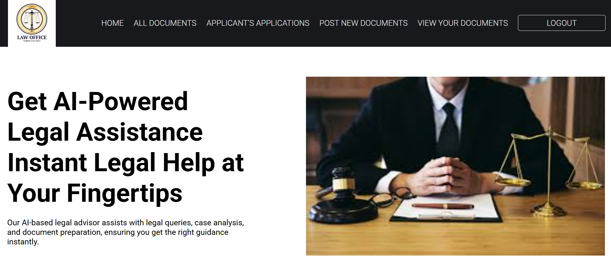
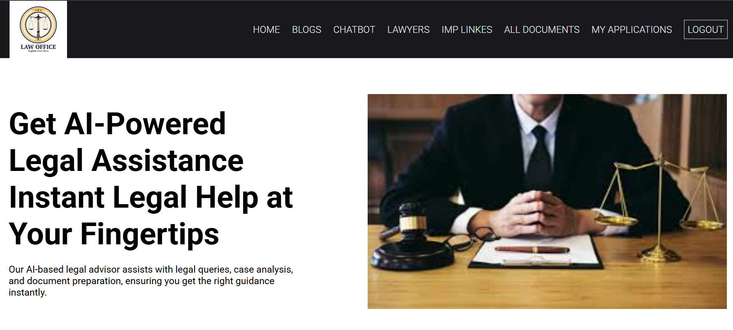
Lawyer Side
The lawyer portal allows legal professionals to manage cases, respond to user queries, and generate legal documents efficiently..
User Side
The user side provides easy access to legal information, chatbot assistance, and document generation for a seamless legal experience

Slide 22
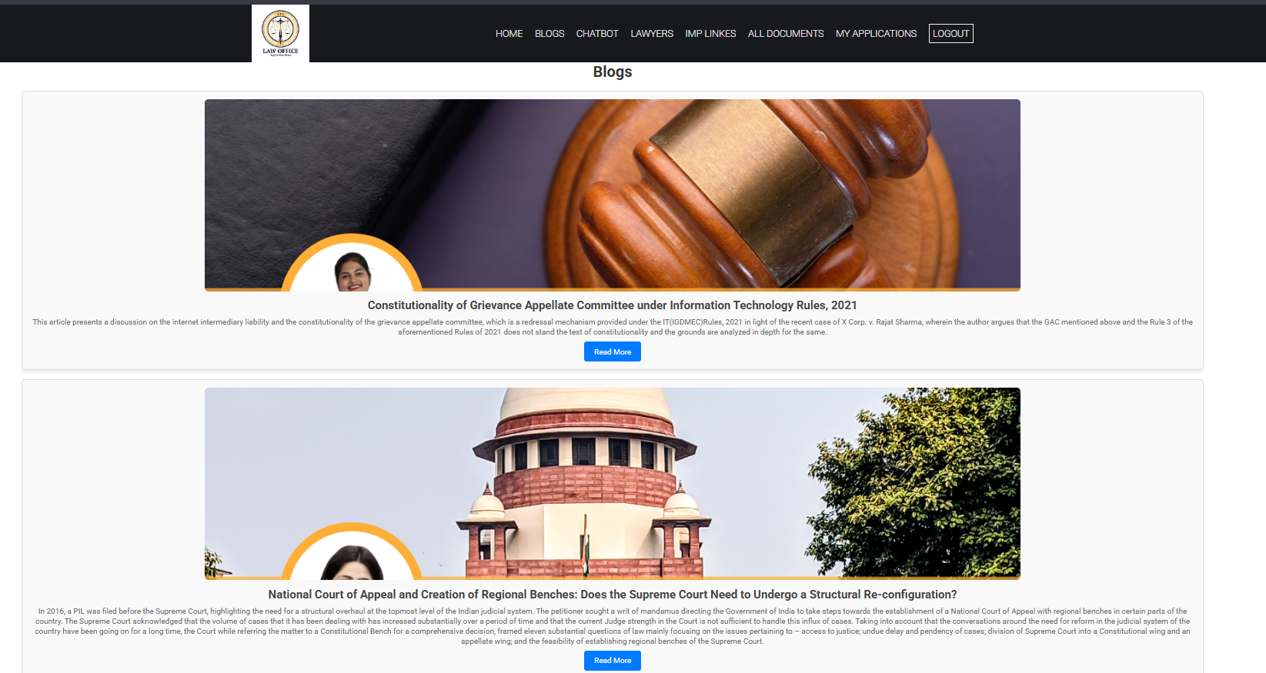
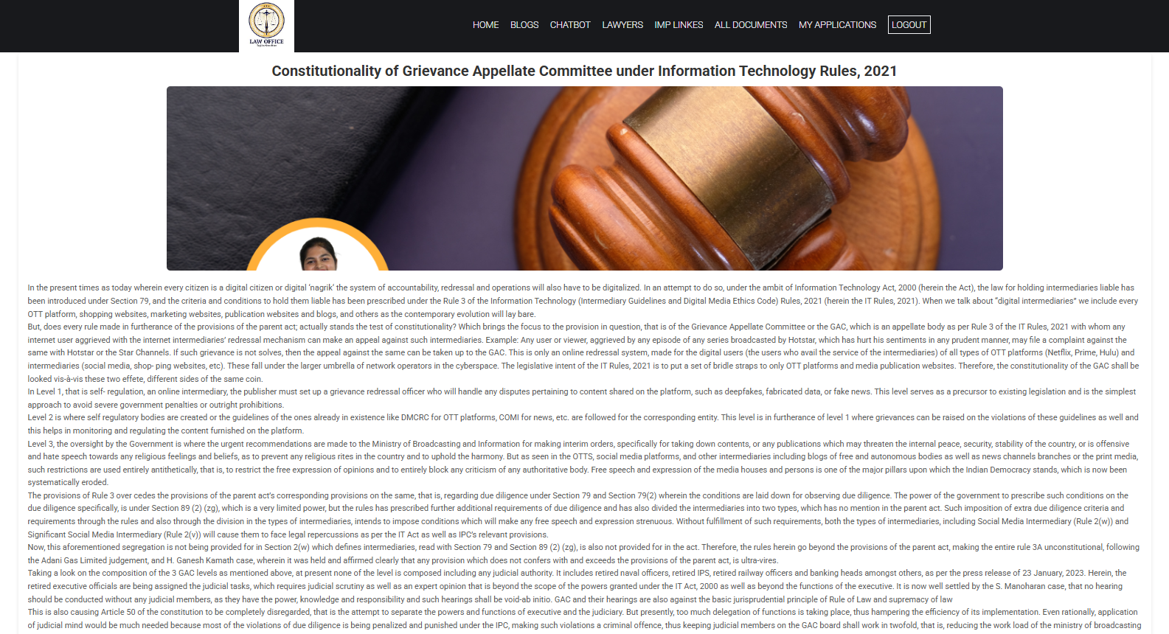
Blogs Page
The blog page offers users access to legal articles, updates, and case studies, enhancing their legal knowledge and awareness.
Blogs Detail
The blog detail page provides in-depth insights on legal topics, allowing users to explore specific cases and laws comprehensively.

Slide 23
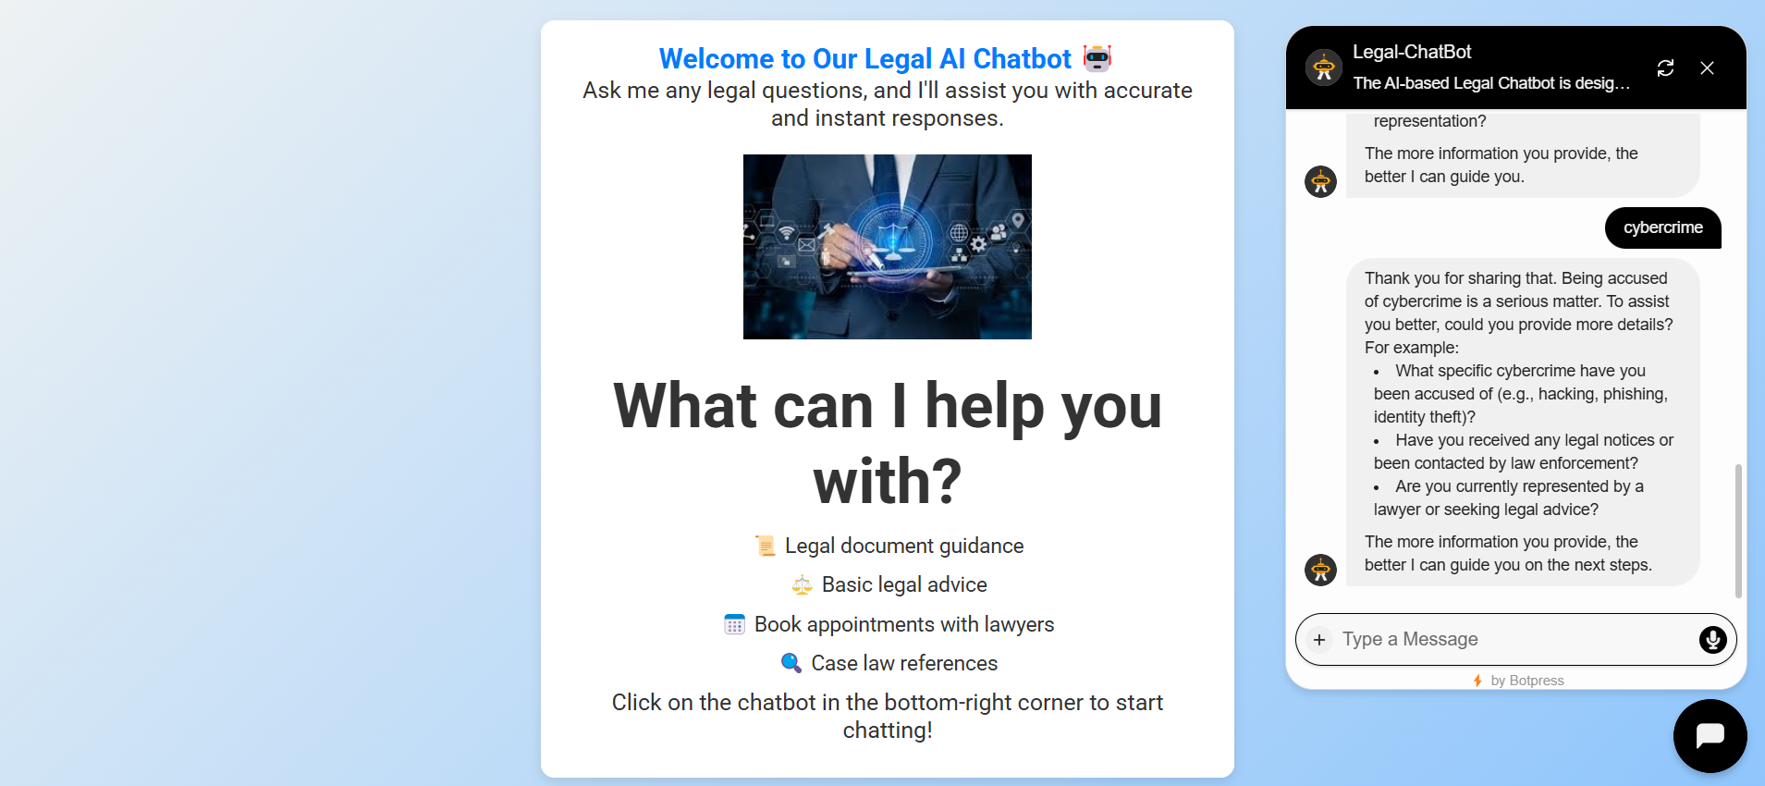
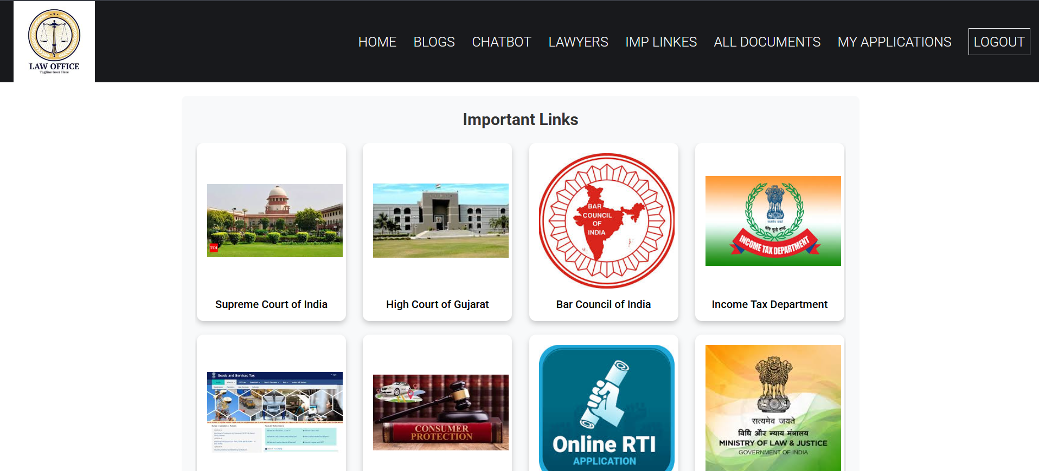
7. Legal-ChatBot
An AI-powered legal assistant providing instant legal guidance, rights awareness, and case-related insights.
8. IMP Linkes
Access official court websites, legal resources, and government portals for case status, judgments, and legal aid

Slide 24
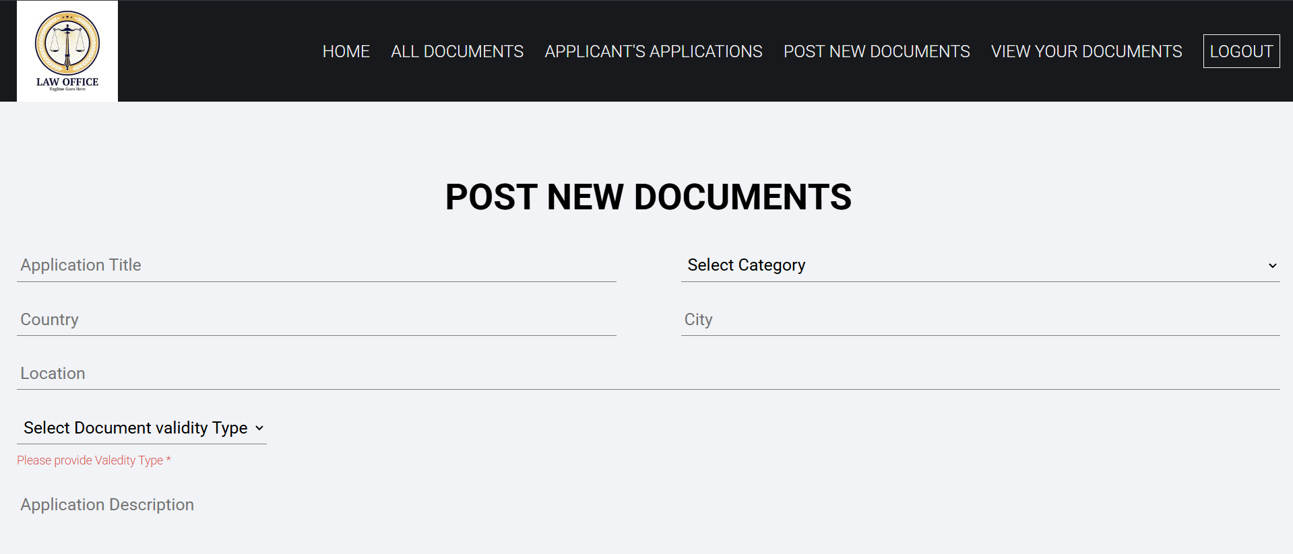
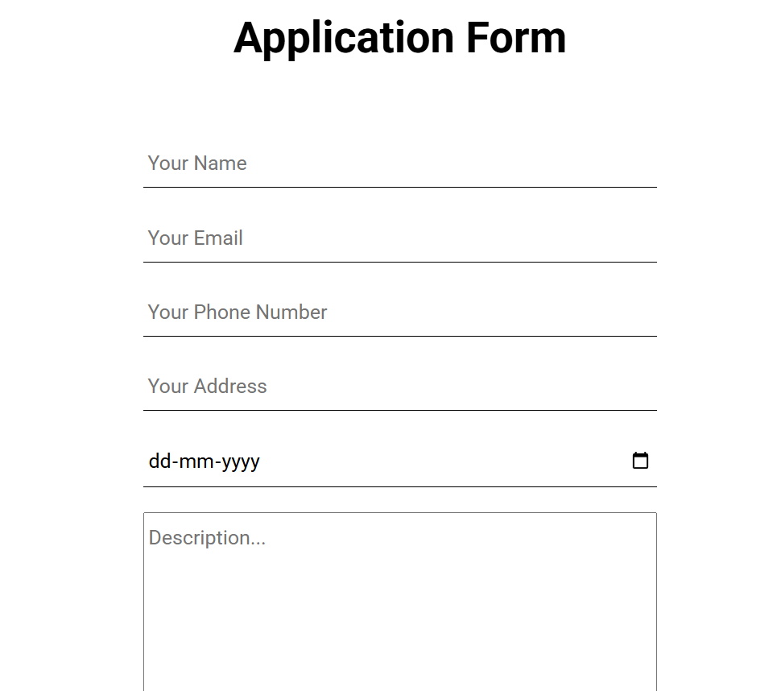
9. Lawyer’s Portal
The document posting feature allows lawyers to upload legal documents, making them accessible for users requiring legal templates and references.
10. User Application Form
The user application form enables users to submit legal case details, ensuring accurate processing and personalized legal assistance.

Slide 25
REFERENCES
[1] AI-Driven Legal Assistants: The Future of Legal Advice – Shah, V. (2023) “Describes how AI-driven legal assistants are transforming legal advice through automation and intelligent interaction.”
[2]AI for Legal Document Automation: A Case Study of Contract Generation – Li, J., & Qin, L. (2022) “Presents a case study on using AI to automate legal contract generation for efficiency and accuracy.”
[3] Legal AI: The Future of Legal Practice and Law Firms – Charlotte Baker, Anthony Thomson (2022) “Explores the integration of AI into legal firms, reshaping traditional legal practice and client services.”
[4] AI in Legal Assistance: Document Automation and Interactive Systems – Pasquale, F. (2021) “Discusses AI technologies that automate legal document creation and support interactive legal systems.”
[5] AI and Legal Decision-Making: Integrating AI for Improved Legal Services – Alejandro Camacho and Robert J. Kirkpatrick (2020) “Examines how AI enhances legal decision-making processes by offering data-driven insights and solutions.”
[6] Natural Language Processing for Legal Text: Challenges and Opportunities – Chalkidis, I., & Androutsopoulos, I. (2020): “Highlights key challenges and opportunities in applying NLP to complex legal documents.”
[7] RoBERTa: A Robustly Optimized BERT Pretraining Approach – Liu, Y., Ott, M., Goyal, N., Du, J., Joshi, M., Chen, D., ... & Stoyanov, V. (2019) “Introduces RoBERTa, an advanced NLP model useful for understanding and processing legal language.”

Slide 26
CONCLUSION
The AI-Powered Legal Advisor Assistant seeks to revolutionize the legal services sector by making these services more accessible, efficient, and user-friendly for both individuals and legal practitioners. Utilizing advanced technologies like Artificial Intelligence and Natural Language Processing, the platform tackles key issues in the legal domain, such as high costs and the heavy workload faced by legal professionals. This cutting-edge solution enables users to manage their legal requirements confidently by providing instant access to accurate information, automating document creation, and simplifying routine tasks. It not only improves operational efficiency for legal professionals but also democratizes legal knowledge, allowing individuals and small businesses to comprehend their rights and responsibilities without incurring excessive costs. As the legal industry evolves, incorporating AI into legal practices becomes crucial, with a focus on ethical standards and user-centered design to maintain transparency and fairness. By prioritizing continuous development and user feedback, the AI-Powered Legal Advisor Assistant has the potential to significantly influence the legal sector, helping build a more knowledgeable society where justice is accessible and understandable, thereby reshaping the future of legal support to promote fairness and assistance for all users.

Slide 27
FUTURE SCOPE
AI-powered legal advisors are revolutionizing the legal industry by enhancing accessibility of legal services, offering 24/7 availability and simplified legal guidance for individuals and small businesses, making legal consultations more affordable. They also enable automation of legal procedures, drafting documents, reviewing contracts, and predicting case outcomes using advanced models. AI assists in legal research integration, retrieving relevant case laws and ensuring regulatory compliance, while in dispute resolution, it supports mediation and alternative dispute processes. AI offers global legal solutions through multilingual capabilities and handles cross-border legal matters. In legal education and training, AI creates interactive learning tools for students and professionals. It enhances data privacy and security by handling sensitive client data and integrating blockchain for secure services. AI also partners with law firms to improve efficiency through hybrid solutions, where repetitive tasks are handled by AI while complex issues go to human lawyers. AI-powered legal chatbots assist with compliance checks in regulated industries and are expanding into niche legal areas such as intellectual property and corporate law.

Slide 28
Thank You!!!

